Slide 1
EE 2361: Introduction to Microcontrollers
Peng Li
lipeng@umn.edu
07/20/2015

Slide 2
Topics
UART Review
SPI

Slide 3
UART Coding Example (uart_pic24.c)
Write and simulate a program which uses the UART to receive and echo characters (8-bit only) at 9600 baud.
Use polled I/O for output and use interrupts for input.
Use RB3/RP3 for Tx and RB7/RP7 for Rx.
For the input, use a 64-byte receive buffer configured as a circular buffer.
Assume no flow-control.

Slide 4
Exercise
Configure the UART unit for a baud rate of 9600 bps, and send seven characters.
Show your baud rate calculations, including the baud rate error.
Write a program to configure the UART unit with the specified baud rate, and then send seven characters. Use polling.
How many instruction cycles (Tcy) is each polling while loop in your program going to take?

Slide 5
SPI
Serial Peripheral Interface (SPI)
Full-Duplex or Half-Duplex
Synchronous
Serial Communication between master & slave device
Applications: Can be used to interface with serial EEPROM, shift registers, display drivers, A/D converters, D/A converters, digital temperature sensors, time-of-day chips, etc.

Slide 6
Standard SPI Master-Slave Communication
One Master & One Slave
Master
Device
Slave
Device
SDI
SDO
SDO
SDI
SCK
SCK
SS
SS
SDI: Serial Data Input
SDO: Serial Data Output
SCK: Shift Clock Input (for the slave device) or Output (for the master device)
SS: Active-Low Slave Select (or data frame sync pulse)
Question: what’s the major difference between the SPI master and slave device?

Slide 7
Master-Slave Protocol
SPI uses a Master-Slave Protocol
The master device controls the Clock (SCK)
No data is transferred unless a clock signal is present.
All slaves are controlled by the master clock.
The slave devices may not manipulate the clock.

Slide 8
Standard SPI Master-Slave Communication
One Master & Multiple Slave
Master
Device
Slave
Device 1
SDI
SDO
SDO
SDI
SCK
SCK
SS1
SS1
SS2
Slave
Device 1
SDO
SDI
SCK
SS

Slide 9
Other Configurations
Three Pin Configuration
Master
Device
Slave
Device
SDI
SDO
SDO
SDI
SCK
SCK
SS
SS

Slide 10
SPI vs UART
SPI | UART
Serial Communication | Serial Communication
Full-Duplex or Half-Duplex | Full-Duplex or Half-Duplex
Synchronous | Asynchronous
Master-Slave (needs SS and CLK) | Transmitter-Receiver (only data)
One master device can connect to multiple slave devices. | One transmitter can only connect one receiver.
Normally used for high speed communication between devices | Normally used for low speed communication between devices
No specific protocol is required. Less overhead. | Needs to follow a certain data format (start bit + 8/9 data bits + stop bit)

Slide 11
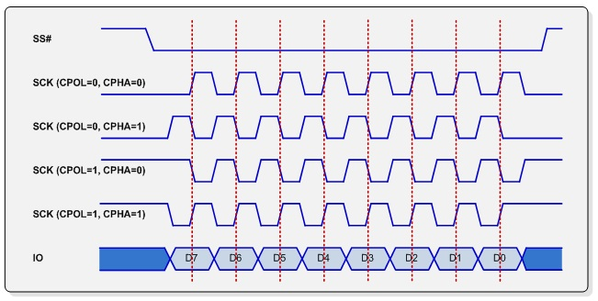
Timing for Data Transfer
When SS (Slave Select) signal becomes low (active), there are four different clock modes for data sampling.
For example, in the first mode, data is sampled at the leading rising edge of the clock. (This mode is the most common mode in the real-world application.)
Figure 2 from this link: http://www.corelis.com/education/SPI_Tutorial.htm

Slide 12
Data Transfer Notes
Data is only output during the rising or falling edge of SCK.
Data is latched during the opposite edge of SCK.
The opposite edge is used to ensure data is valid at the time of reading.

Slide 13
SPI Input / Output Review
SS: Active-Low, Chip Select or Slave Select. When this signal goes low, the slave will listen for SPI clock and data signals.
SCK: Serial Clock This Controls when data is sent and when it is read.
SDO: Serial Data Output This signal carries the data sent out of the device.
SDI: Serial Data Input This signal carries the data sent into the device.

Slide 14
SPI Data Transfer Block Diagram
Shift Register
Shift Register
Page 148 of datasheet.

Slide 15
SPIxBUF Registers
SPIxBUF: this register is used to buffer data to be transmitted (SPIxTXB) and data that is received (SPIxRXB).
The SPIxBUF register is actually comprised of two separate registers: the Transmit Buffer, SPIxTXB, and the Receive Buffer, SPIxRXB.
These two unidirectional, 16-bit registers share the SFR address of SPIxBUF.
If a user writes data to be transmitted to the SPIxBUF address, internally the data is written to the SPIxTXB register.
Similarly, when the user reads the received data from SPIxBUF, internally the data is read from the SPIxRXB register.
Users do not have the access to the SPIxTXB or SPIxRXB register. They are virtual registers.

Slide 16
Status Registers
SPIEN: SPI module enable bit. 1 – Enable; 0 – Disable
SPIROV: Receive Overflow Flag bit. 1 – New data arrived, but CPU has not read previous data in the SPIxBUF register. 0 – No overflow.

Slide 17
Status Registers (cont.)
SPIxTBF: SPI Transmit Buffer Full Status Bit. (1 – Full; 0 – Empty) SPIxTBF is automatically set in hardware when SPIxBUF is written, and is automatically cleared in hardware when SPI transfers data from SPIxTXB to SPIxSR.
SPIxRBF: SPI Receive Buffer Status Bit. (1 – Full; 0 – Empty) SPIxRBF is automatically cleared in hardware when SPIxBUF is read, and is automatically set in hardware when SPI transfers data from SPIxSR to SPIxRXB.

